Slide 1
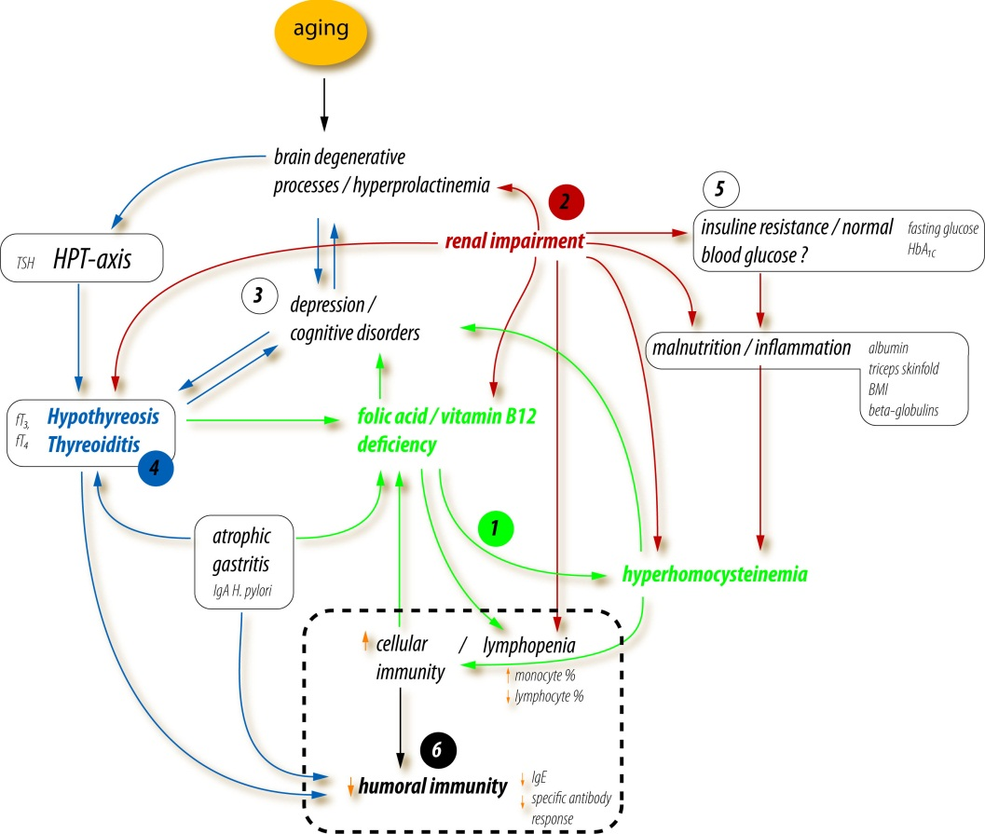
Possibilities of a systems biology approach in managing simple, clinical parameters
Ljiljana Trtica-Majnarić
School of Medicine, University J.J. Strossmayer Osijek
Osijek, Croatia

Slide 2
A complex problem-solving task analysis, in the area of preventive medicine
A case study - low antibody response to influenza vaccination

Slide 3
A research question
How to identify subjects who are likely to poorly respond to influenza vaccine?
(trivalent, inactivated, annually applied vaccine,
for elderly (≥65 y) and chronically ill patients)
Important
For planning influenza vaccination protocol
(new vaccines and vaccination approaches available)

Slide 4
Background
Influenza vaccine efficacy is significantly lower in the elderly
than in younger population groups
Proposed factors mutually interdependent
Older age
(≥ 65 years)
Chronic diseases
(health parameters)
Influenza viruses
different vaccine status and differences in past infections
a major difficulty for modelling
A methodology approach
Models of prediction

Slide 5
A new research question
How to identify health parameters suitable for general use (in models of prediction)?
A complex problem-solving approach
Limited theoretical background
(unknown immunoregulatory mechanisms)
A wide range of poorly identified health factors
(stages of a disease, co-morbidity, biochemical disorders, lifestyles)

Slide 6
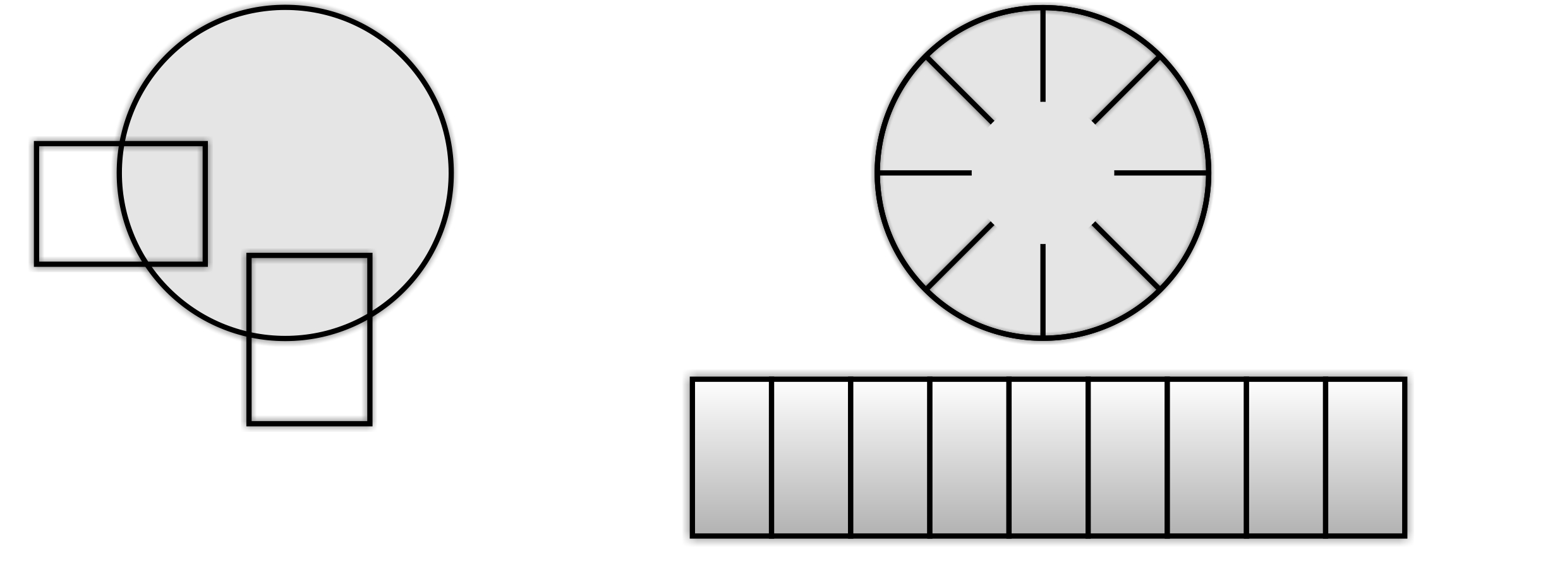
A methodology approach?
A reductionist approach
Only recognised, directly relevant
variables are used
Strongly hypothesis-driven
A system-biology approach
All (almost all) components of the system are considered
Hypothesis-free
Research protocol
Computationally intensive - the use of advanced techniques

Slide 7
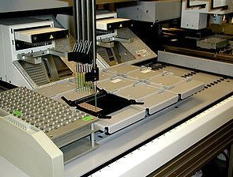
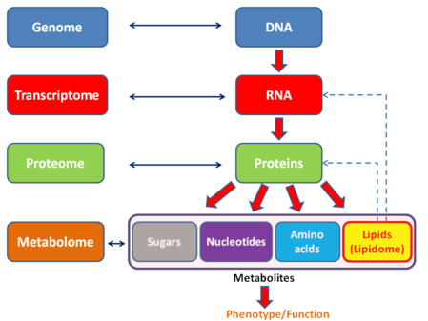
A systems biology/Machine Learning
Originally applied in the emerging field of metabolomics
(genomics, proteomics...)
A whole cell / tissue content analysis
A study of pathways and networks in biological systems

Slide 8
A systems biology approach
systematic data recording / a multi-step research protocol / predictive modelling
Theory
Data Mining modelling
Definite, statistically significant validation
Definition of a research question
Searching through published papers for basic information
Data collection
Computation based on using Machine Learning techniques
Building models of prediction
A visual model of the biological network

Slide 9
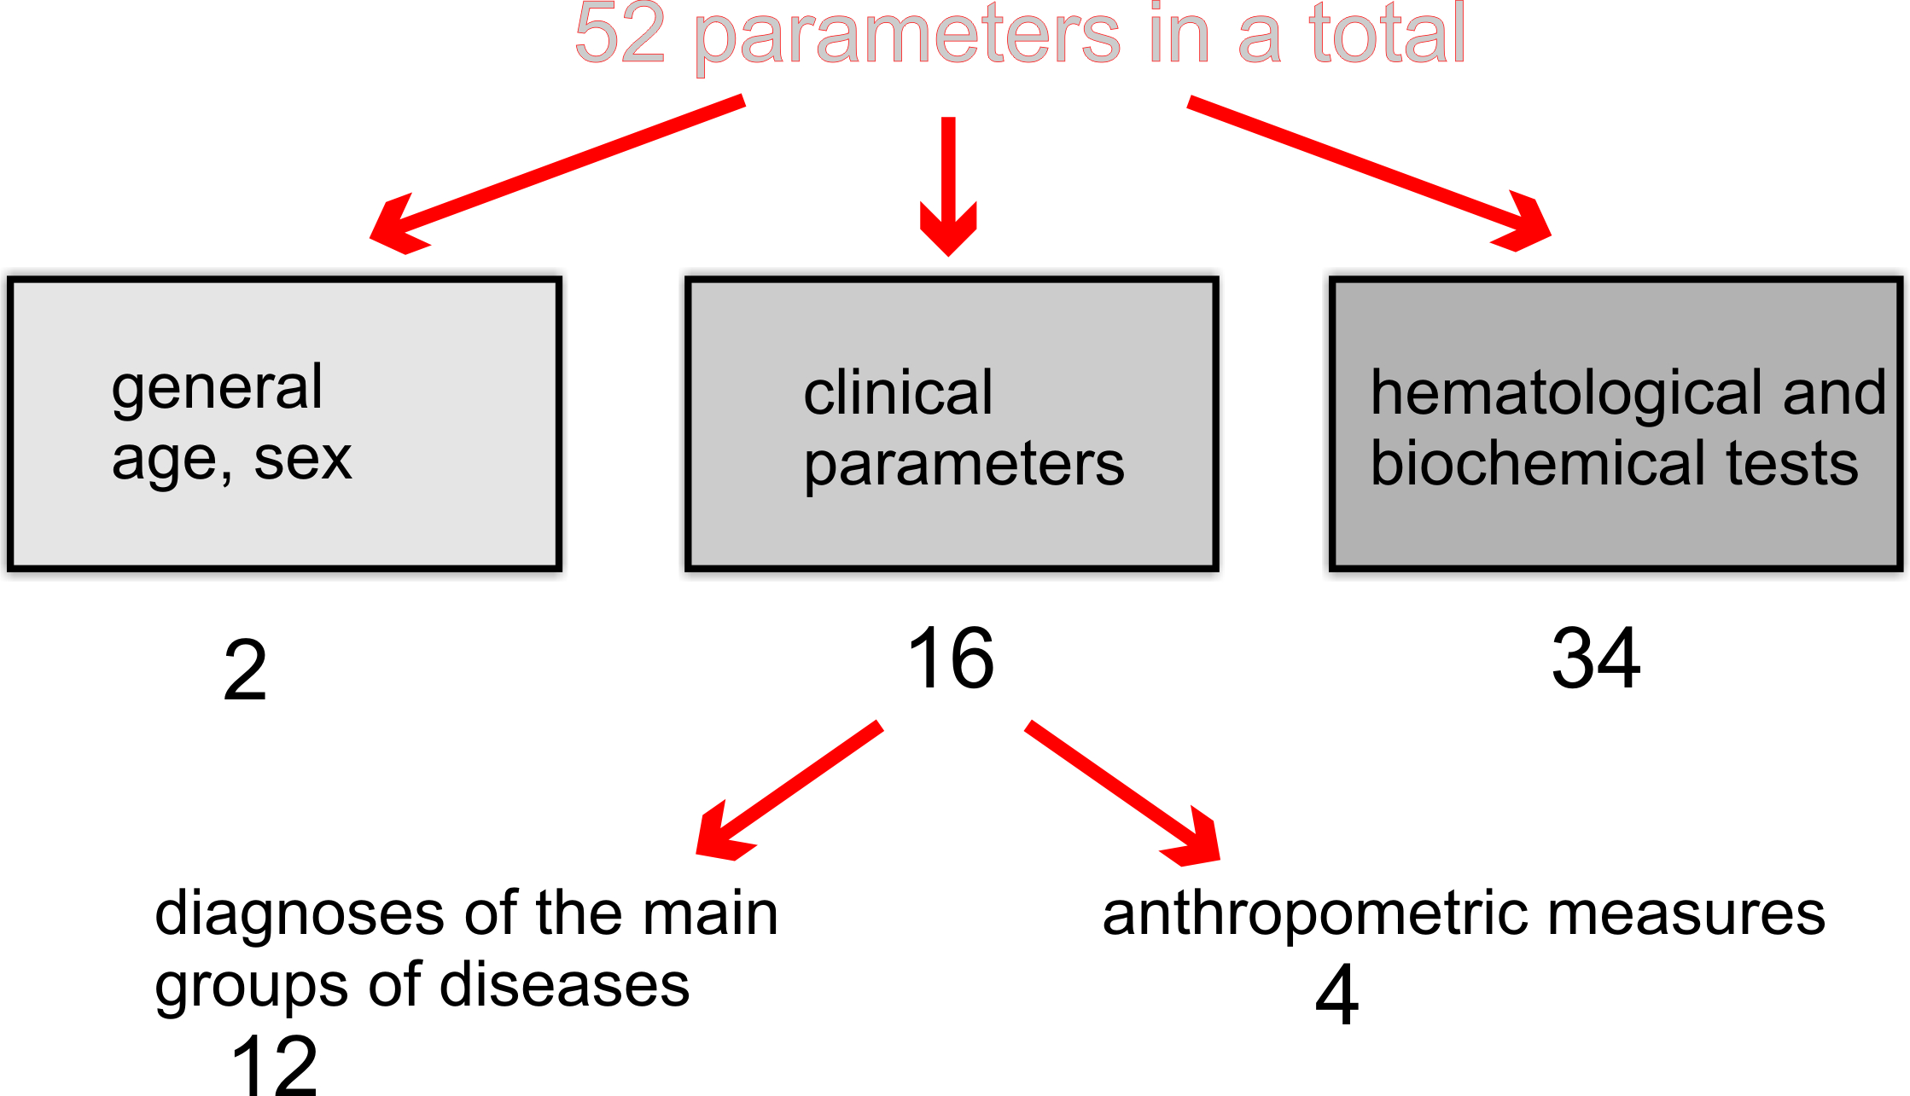
A dataset
The sample
93 (35M, 58 F)
50-89 y (M 69)
Laboratory tests indicating
Inflammation
Nutritional status
Metabolic status
Chronic renal impairment
Latent chr. infections
Humoral immunity
Neuroendocrine status

Slide 10
Performed laboratory tests
Inflammation: WBC* count, WBC differential (% neutrophils, lymphocytes, eosinophils, and monocytes), CRP, and serum proteins electrophoresis (α1, α2, β, γ-globulins)
Nutritional status: RBC count, haemoglobin, MCV, iron, serum albumin, folic acid, vitamin B12, and homocysteine
Metabolic status: fasting glucose, HbA1c, total cholesterol, HDL-cholesterol and triglycerides
Chronic renal impairment: Creatinine clearance
Latent infections: Helicobacter pylori specific IgA and IgG and cytomegalovirus specific IgG
Humoral immunity: IgE and ANA
Neuroendocrine status: Blood cortisol in the morning, TSH, fT3, fT4, and prolactin
*Abbreviations
WBC (white blood cell); CRP (C-reactive protein); RBC (red blood cell); MCV ( mean cell volume); HbA1c (glycosilated haemoglobin); HDL (high-density lipoprotein); ANA (antinuclear antibodies); TSH ( thyroid-stimulating hormone); fT3 (free triiodothyronine); fT4 (free thyroxine)

Slide 11
Data mining - finding patterns in the data
Attribute ranking | Attribute | Cut-off value | Statistically significant properties
 |  |  | Sensitivity % | Specificity %
Model No. 1 1. | Monocyte % | > 8,0 (%) | 90,0 | 70,8
2. | vitamin B₁₂ | ≤ 212,0 (pmol/L) | 80,0 | 75,0
3. | homocysteine | >12,7 (μmol/L) | 80,0 | 75,0
4. | fT₄ | ≤13,65 (pmol/L) | 70,0 | 79,1
5. | Creatinine cl. * | ≤1,55 (ml/s/1.73m²) | 70,0 | 75,0
6. | skinfold thickness | ≥ 32,50 (mm) | 80,0 | 62,5
Model No. 2
1. | Monocyte % | > 7,85 (%) | 71,4 | 73,6
2. | g-globulins | >13,05 (g/L) | 64,2 | 78,9
3. | MCV | >90,50 (fl) | 78,5 | 63,1
4. | H.pylori IgA | >11,80 (IU/ml) | 78,5 | 63,1
5. | prolactin | >90,24 (mIU/L) | 85,7 | 57,8
6. | b-globulins | >8,50 (g/L) | 64,2 | 73,6
Model No. 3
1. | Lymphocyte % | ≤ 35,10 (%) | 65,6 | 63,6
2. | fT₄ | ≤13,65 (pm/L) | 59,3 | 68,1
3. | Fasting glucose | ≤5,45 (mol/L) | 50,0 | 77,2
4. | b-globulins | ≥8,05 (g/L) | 53,1 | 72,7
5. | Monocyte % | >7,95 (%) | 65,6 | 56,8
6. | Serum albumin | <45,35 (g/L) | 75,0 | 54,54
Model No. 4
1. | Lymphocyte % | ≤ 35,40 (%) | 56,7 | 89,4
2. | Monocyte % | >7,95 (%) | 59,7 | 84,2
3. | Skinfold thickness | ≤ 34,50 (mm) | 65,6 | 73,6
4. | fT₄ | ≤ 14,5 (pmol/L) | 71,6 | 63,1
5. | age | > 65,5 (years) | 71,6 | 63,1
6. | TSH | >1,39 (UI/ml) | 59,7 | 68,4
*Abbreviations: fT₄ (free thyroxine), Creatinine cl. (Creatinine clearance), MCV (Mean Cell Volume), H. (Helicobacter) pylori, TSH (thyroid-stimulating hormone)

Slide 12
Data mining - a pool of 16 selected parameters
Data Mining models. | Parameters selected in a particular model CLINICAL CONDITIONS | Parameters overlapping in 2 or more models INTERMEDIATE MECHANISMS
Model No. 1 | Creatinine clearance, Homocysteine | Monocyte %, Vitamin B₁₂, fT₄, Triceps skinfold thickness
Model No. 2 | H. pylori IgA*, γ-globulins, Prolactin | Monocyte %, MCV [indicating vitamin B₁₂], β-globulins
Model No. 3 | Fasting glucose, Serum albumin | Monocyte %, Lymphocyte %, fT₄, β-globulins
Model No. 4 | Age, TSH | Monocyte %, Lymphocyte %, fT₄, Triceps skinfold thickness
*Abbreviations: H. (Helicobacter) pylori, fT4 (free thyroxine), MCV (Mean Cell Volume), TSH (thyroid-stimulating hormone)

Slide 13
Four LR models
By varying criteria for definition of the model`s outcome measure
(7 health parameters used)
Attribute ranking | Attribute | Estimated parameter | p-value
Model No. 1
1. | AGE | 0.0526 | 0.0013
2. | KONG_1 | 0.0843 | 0.0117
3. | VACC (0) | 1.8036 | 0.0575
4. | H1N1_1 | -0.0241 | 0.0721
5. | VACC (1) | 2.0287 | 0.0382
6. | SICM_1 | -0.0133 | 0.0976
Model quality: Likelihood ratio = 42.428 [p=0.0001]; c = 0.863 ; Somers’ D = 0.725; AIC = 128.142
Model No.2
1. | HOMCYS | 0.1922 | 0.0132
2. | FT4 | -0.1790 | 0.0992
3. | H1N1_1 | 0.0472 | 0.0892
4. | VACC (1) | 1.1912 | 0.0871
5. | VACC (2) | 1.4516 | 0.0633
Model quality: Likelihood ratio = 20.022 [p=0.0012]; c = 0.764 ; Somers’ D = 0.528; AIC = 124.156
Model No. 3
1. | HPA | -0.0375 | 0.0268
2. | FT4 | -0.6004 | 0.0314
3. | VITB12 | -0.00632 | 0.0708
4. | GAMA | 0.5176 | 0.0646
Model quality: Likelihood ratio = 20.945 [p=0.0003]; c = 0.897 ; Somers’ D = 0.794; AIC = 51.961
Model No. 4
1. | LY | 0.0759 | 0.0053
2. | VACC (1) | -1.7413 | 0.0118
3. | VITB12 | 0.00301 | 0.0095
4. | SICM_1 | -0.0300 | 0.0400
5. | FT4 | 0.2290 | 0.0687
Model quality: Likelihood ratio =30.759 [p=0.0001]; c = 0.834 ; Somers’ D = 0.669; AIC = 123.263

Slide 14
Subsequent data mining
transforming selected parameters into disorders

Slide 15
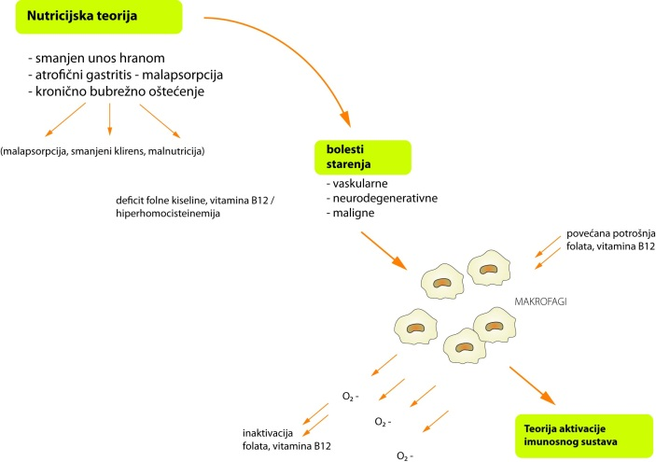
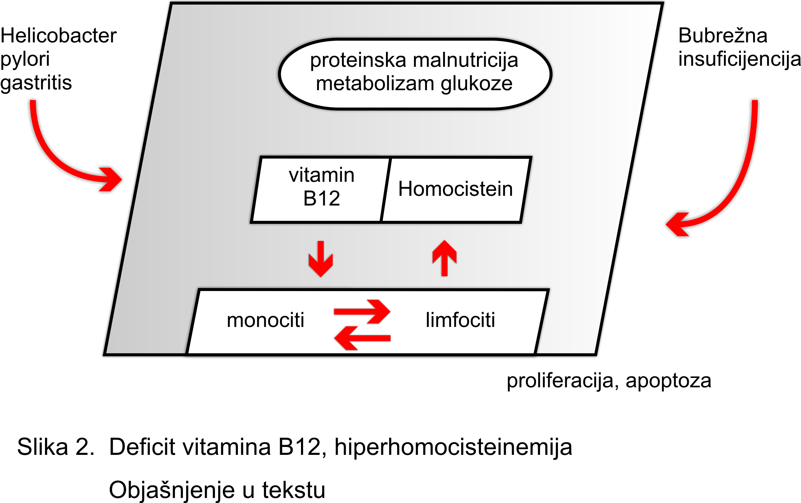
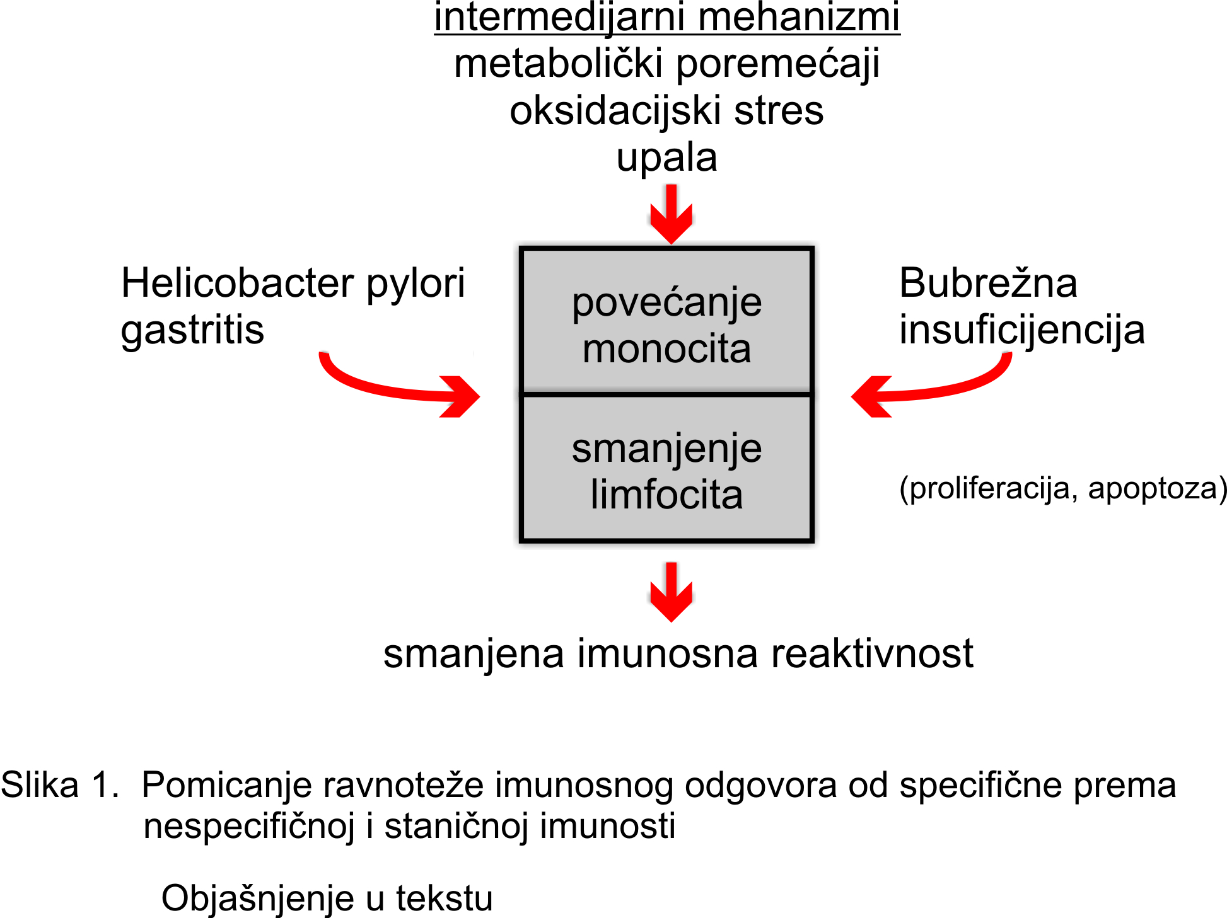
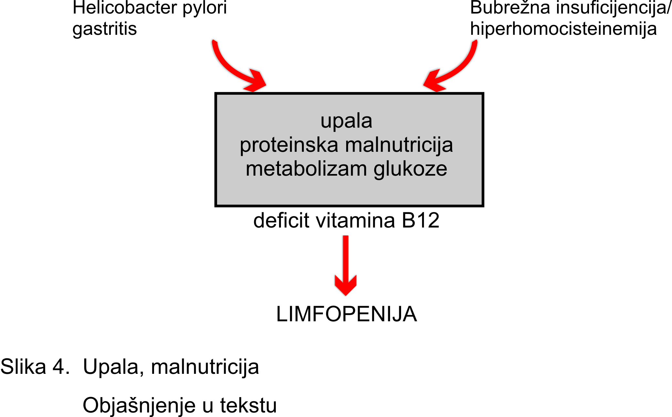
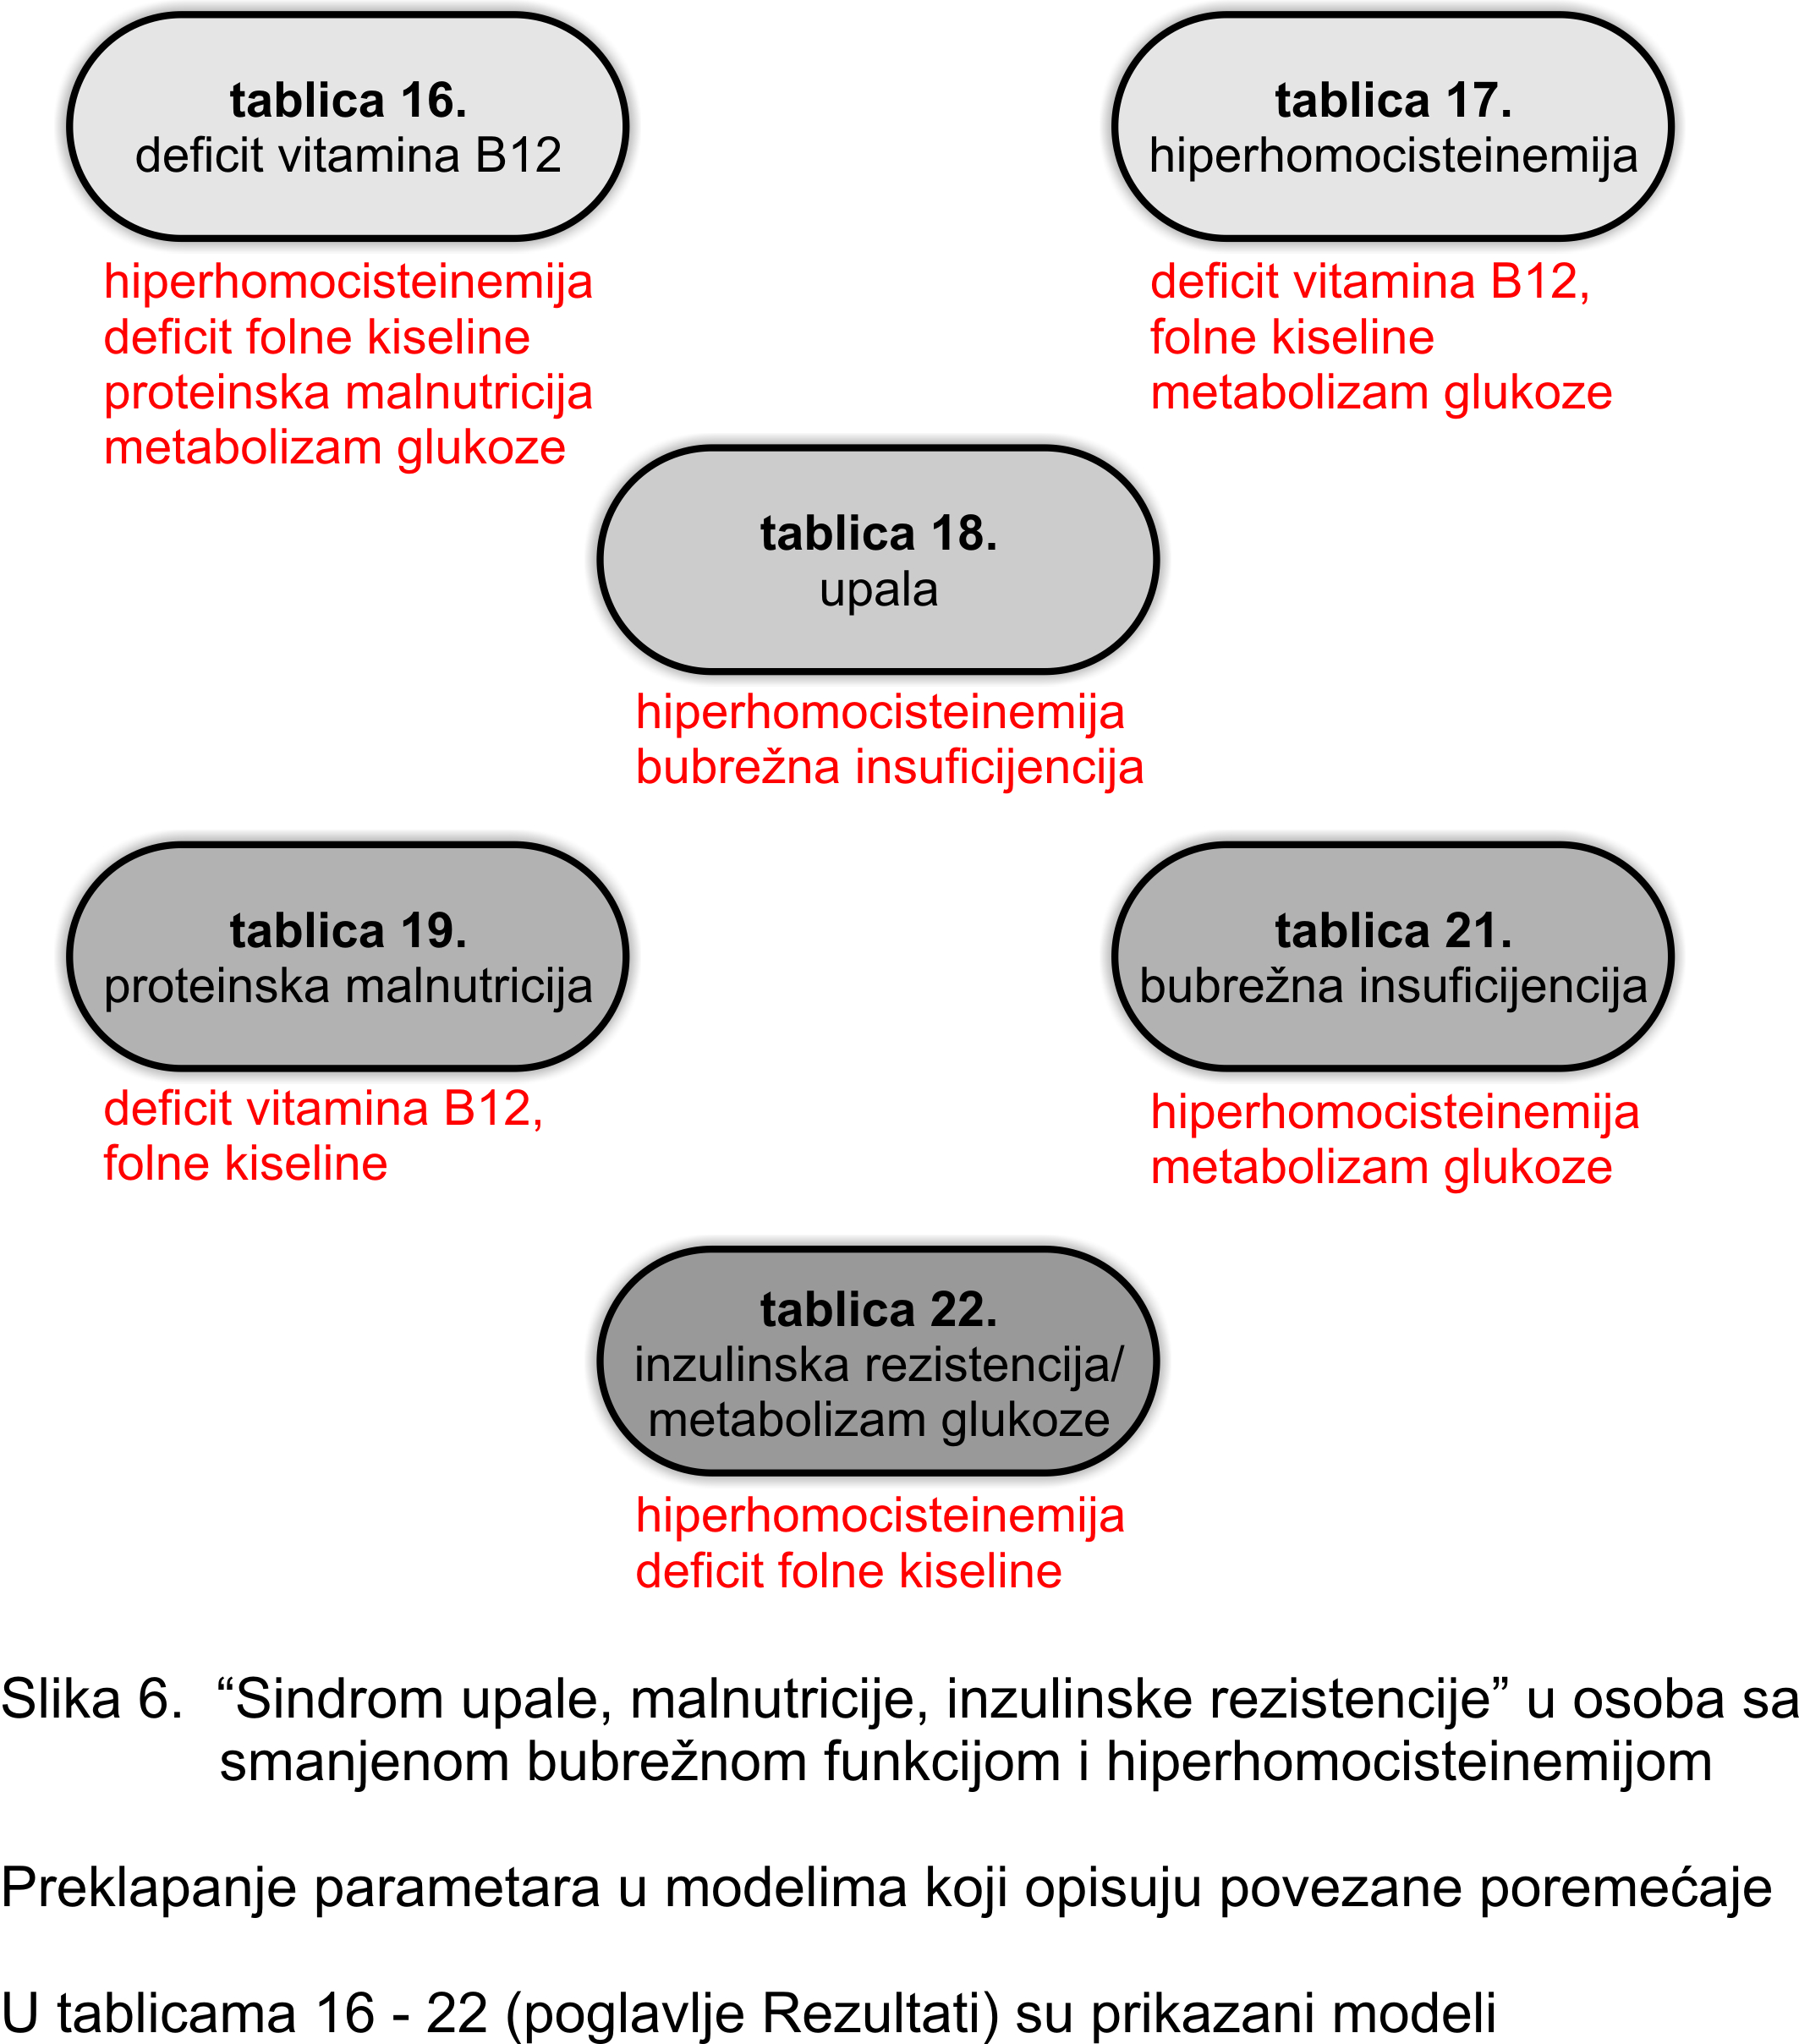
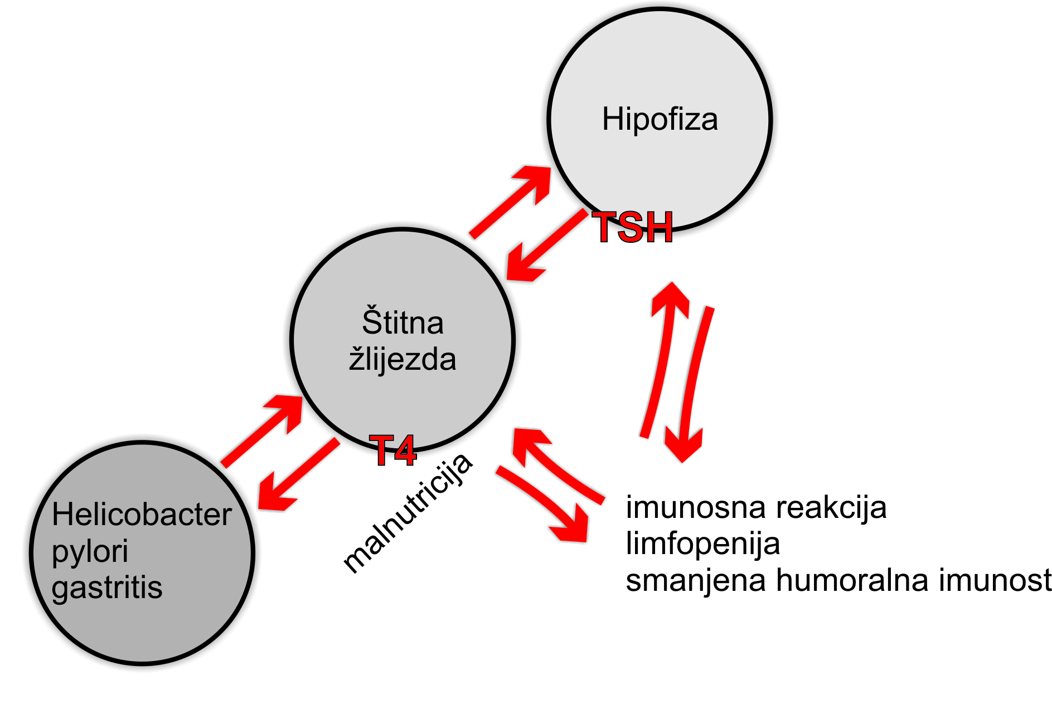
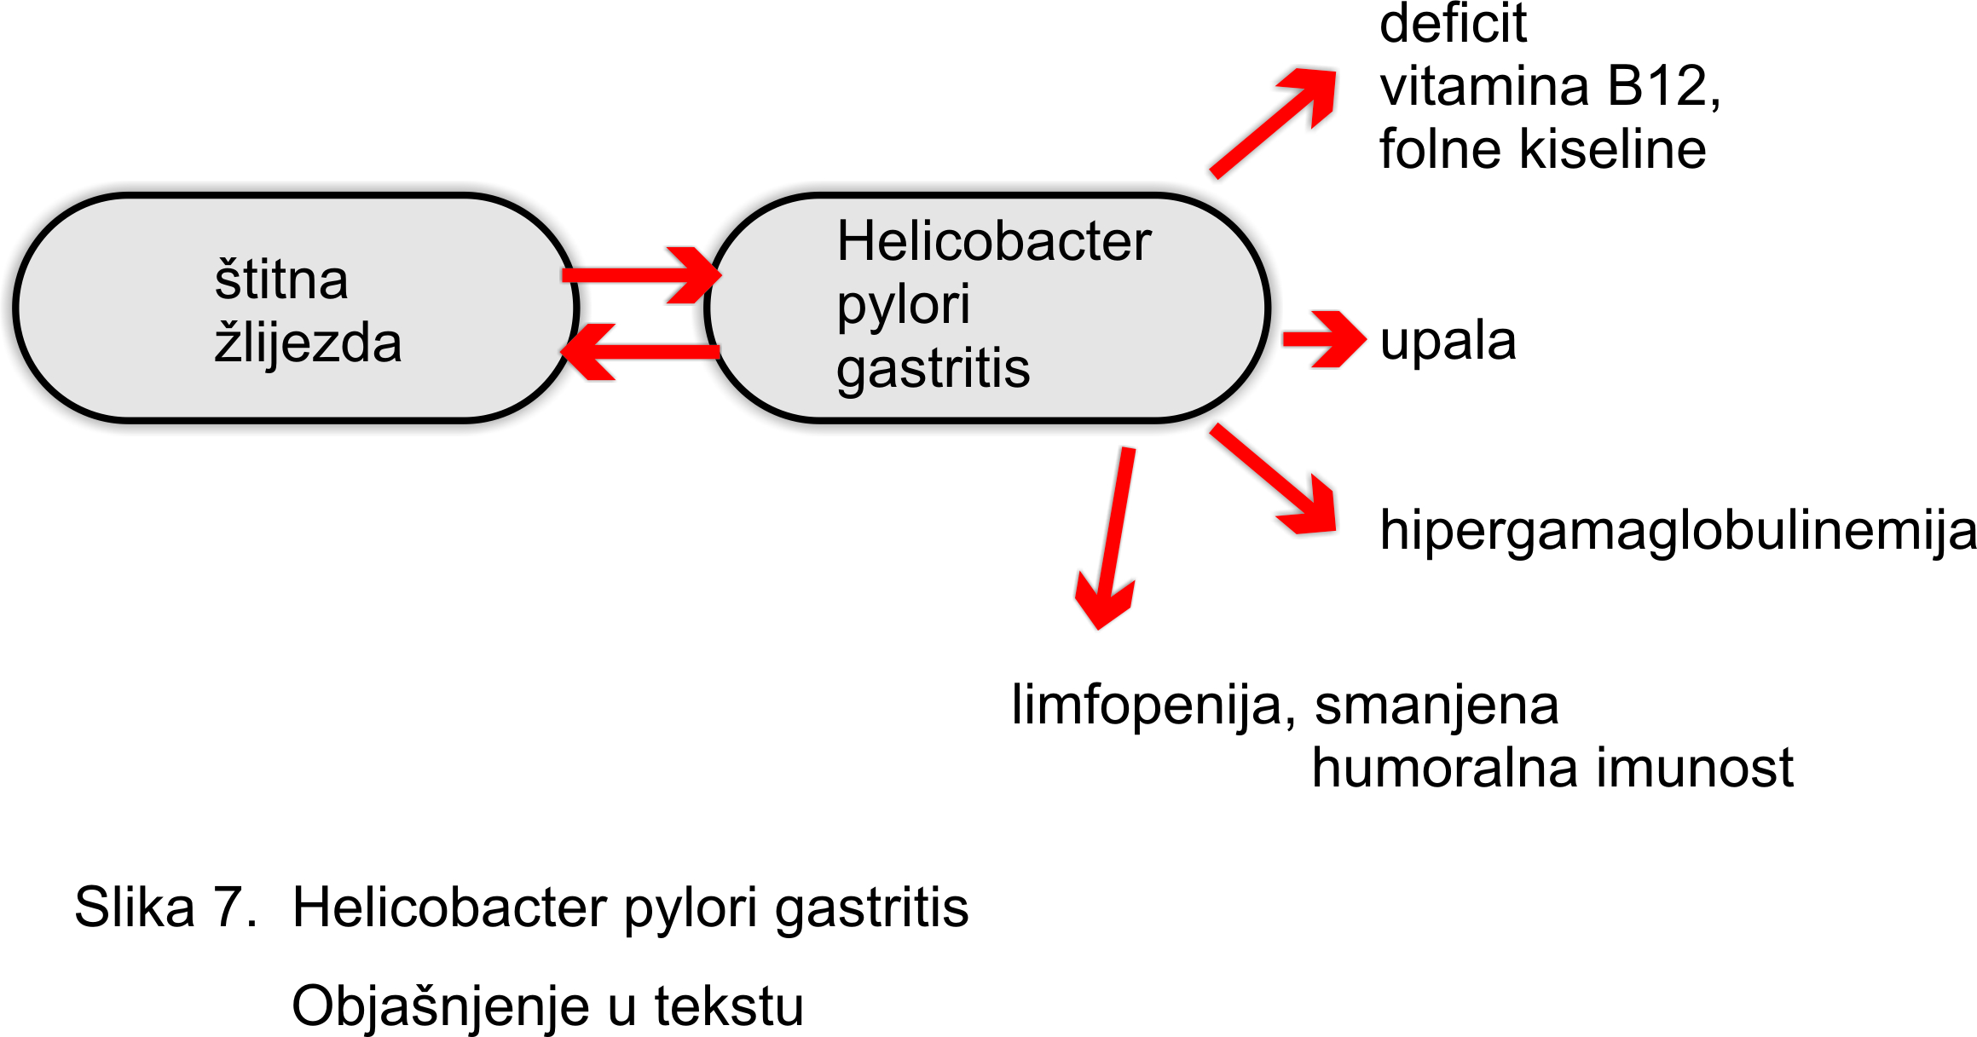
Constructing a visual model of the biological network, supported by expert knowledge
A series of cognitive patterns

Slide 16
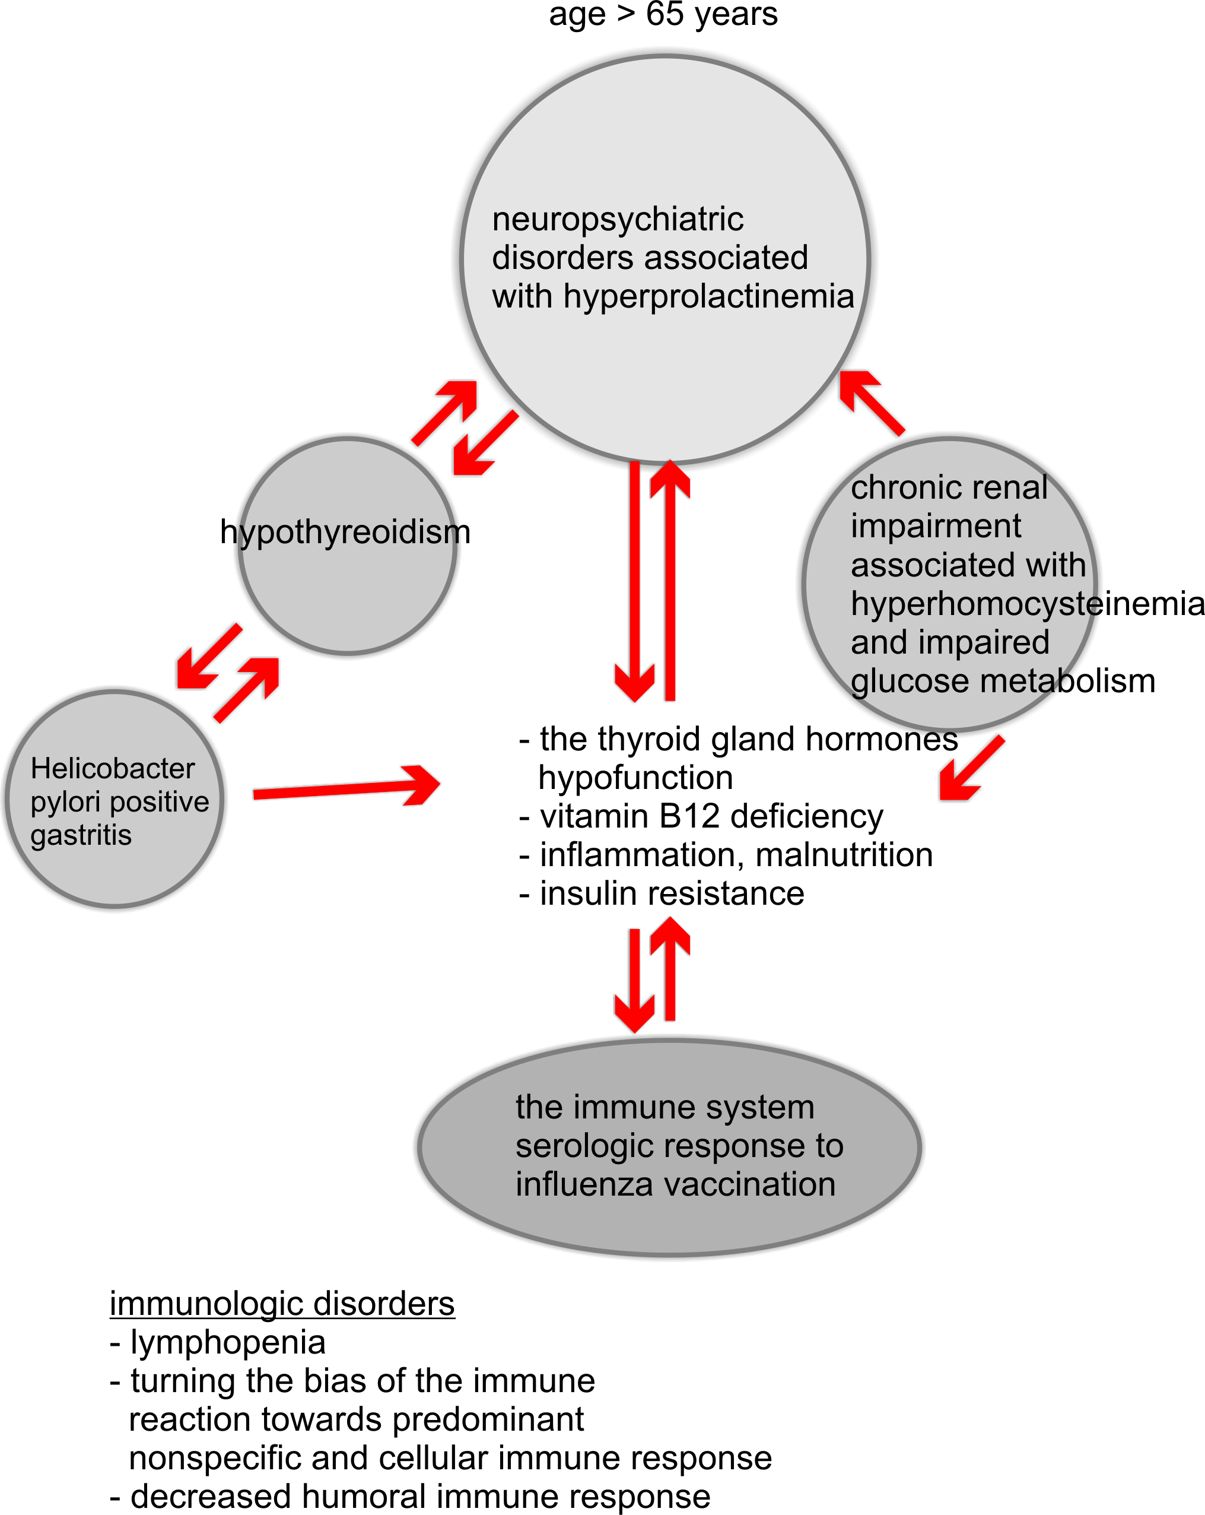
A visual model
of the biological network
Benefits
Clinical conditions, relationships and mechanisms
mapped within a large, poorly recognised input space
Selected health parameters placed into clinical context
Improved understanding
A decision-making support tool
A starting position for research

Slide 17
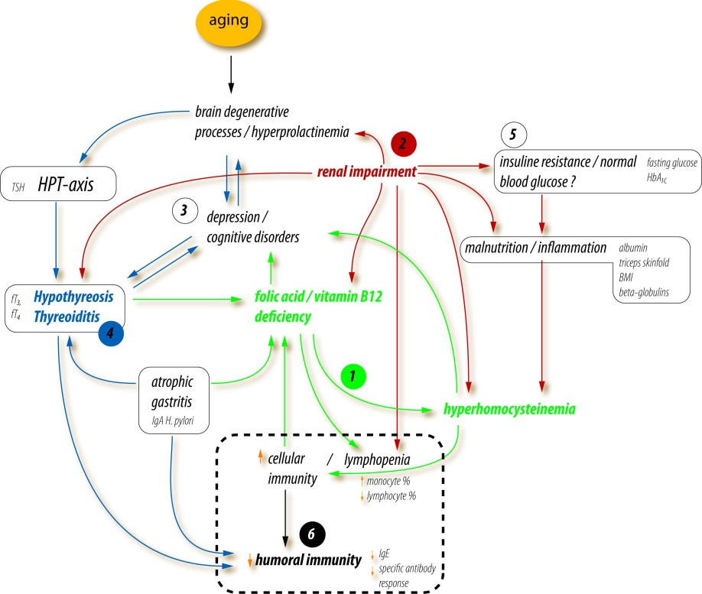
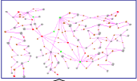
A systems biology - a study of pathways and networks

Slide 18
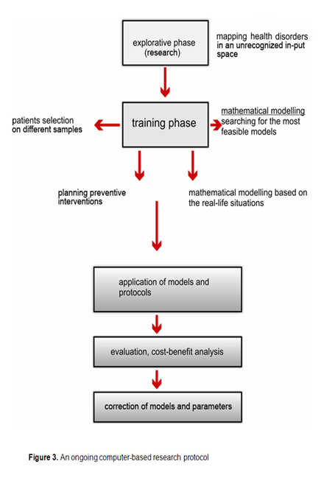
An ongoing computer-based research protocol

Slide 19
A complex problem-solving approach, in the situated, real life scenario
A need for developing a conceptual framework to promoting a complex problem-solving oriented research
research agenda should determine
research methods ...
... opposite to what is nowadays, when the clinical projects are to meet the criteria for the classical research design
based on using reductionist methods
a systems biology approach,
based on intensive computerisation, seems promising
a partnership between
a computer programmer & an expert

Slide 20
Challenges for SB in planning preventive strategies for chronic aging diseases
Preventive strategies could be improved and economically justified if relied on the possibility of identifying factors responsible for prediction of the outcomes and/or definition of the target groups
For many preventive tasks, risk and prediction factors have not yet been identified
It is not possible to select subjects into the target groups according to the diagnosis of a disease, but rather on using multiple factors...
Due to the characteristics of chronic aging diseases
gradually changing continuum from health to a disease
frequent subclinical disorders
overlapping in genetic and environmental risk factors
shared clinical expression among related disorders
Consequences at the clinical level
several diseases and disorders occure in one person
the great interindividual diversity (including the number, combination and stages of disorders)
heterogeneity of the studied groups

Slide 21
Possibilities of a SB as a multidimensional analytical method
The first step knowledge discovery, for a computer-based problem simulation
Preferences
General conclusions drawn from small samples
A larger spectrum of research questions are getting a chance of being solved (for problems lacking in evidence, complex real life problems)
Introductory to research in chronic aging diseases and co-morbidity
More specific identification of the target groups - an improvement beyond the traditional screening methods
Information from other sources (on family history, socio-economic status, local environment, occupation, specific genetic traits or biomedical markers, genomics) can be added to the basic health dataset - various comprehensive conclusions, based on modelling
Contribution to the preventive health programs implementation

Slide 22
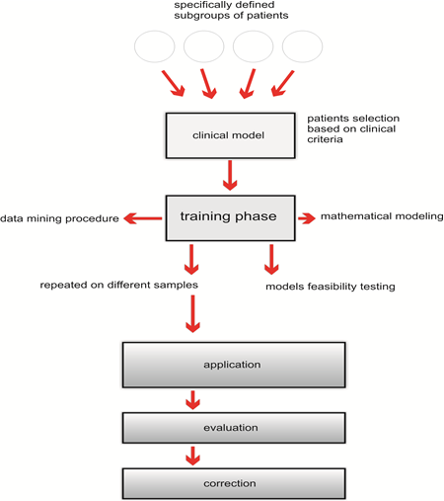
More specific identification of the target groups

Slide 23
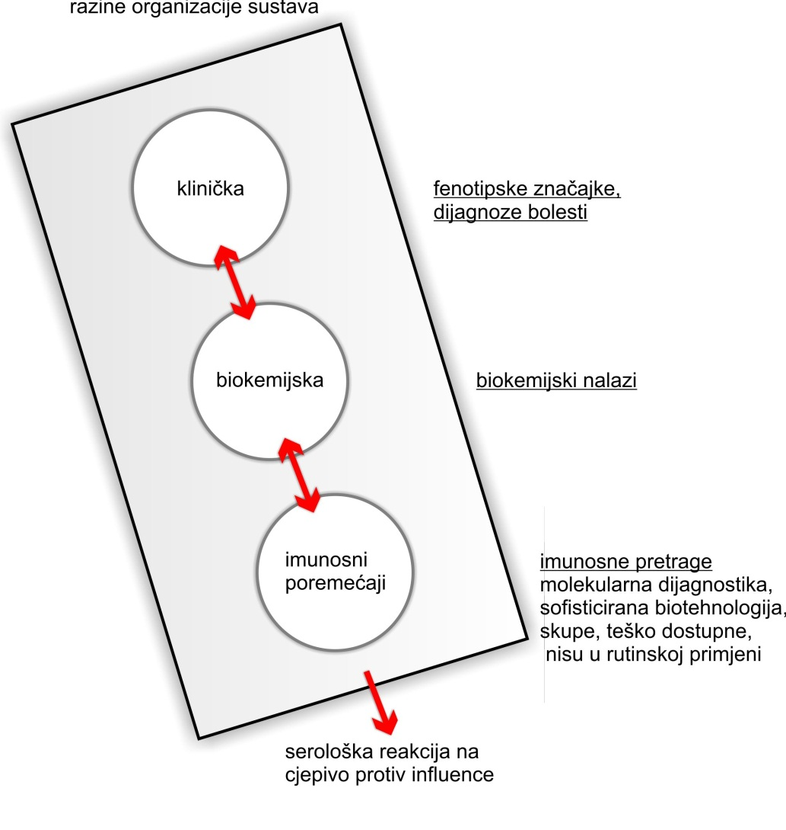
A state of equilibrium - a possibility to replace molecular biology markers with biochemical and clinical parameters

Slide 24
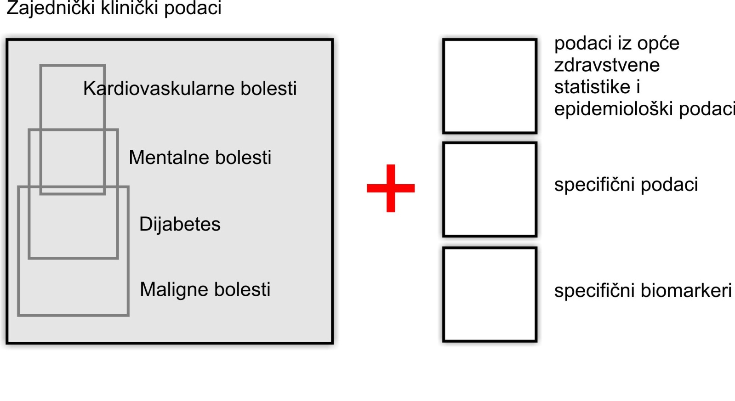
Shared parameters for predicting the most common chronic aging diseases

Slide 25
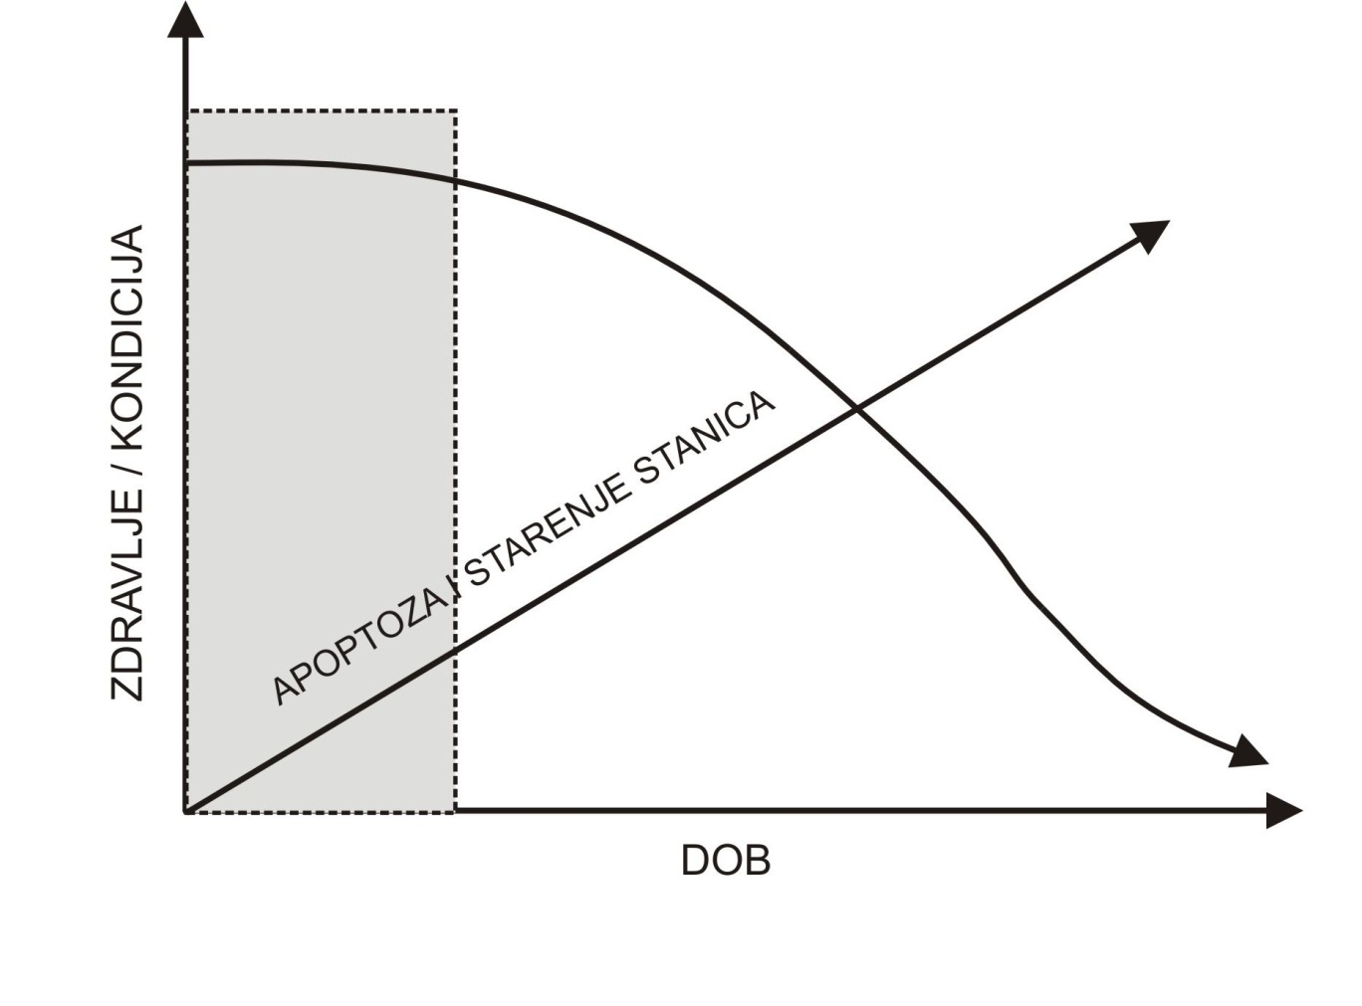
A cellular homeostasis
Apoptosis and a cell cycle

Slide 26
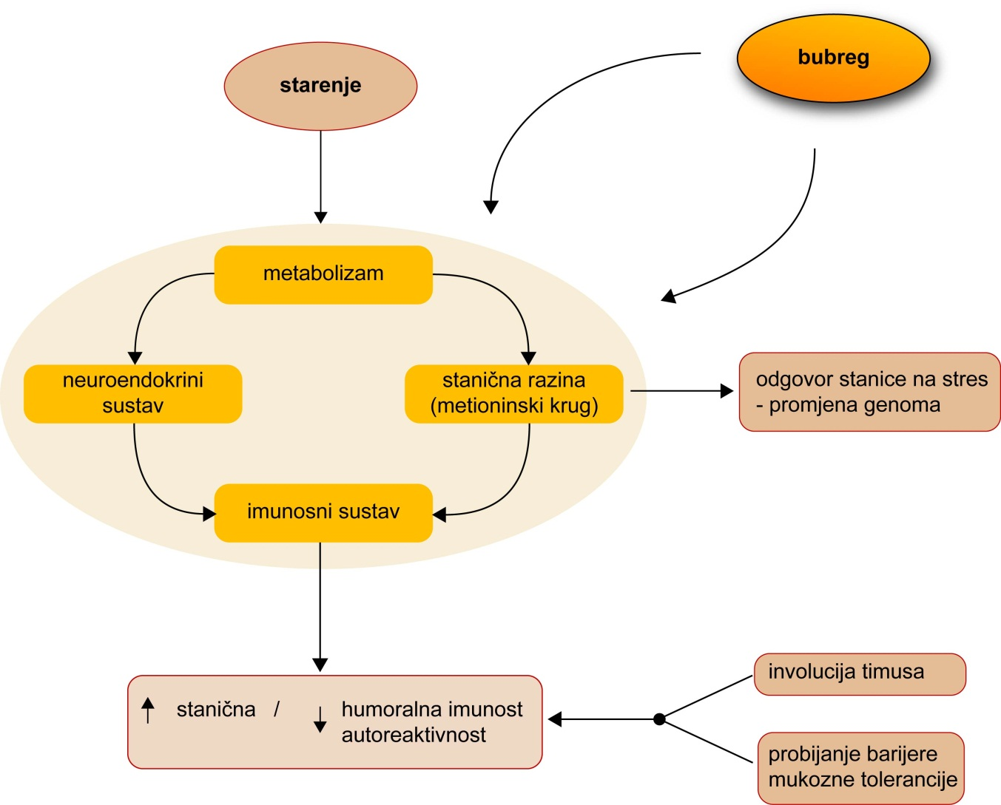
A cellular homeostasis
Apoptosis and a cell cycle

Slide 27
Possibilities of a SB in CV risk prediction
Risk charts and scores have been developed to assess the risk for CV events
The major risk factors were identified a long time ago, but evidence indicates the need for adding new risk factors into revised scores
- DM, pre-diabetes and metabolic sy states, hyperhomocysteinemia, chronic renal impairment, latent infections (CMV, HP), complex socioeconomic factors
Up to 1/3 of the first coronary events occur among individuals without conventional risk factors
Experiences gained so far in the early detection of DM type 2 - the risk assessment depends on the characteristics of the studied population; it is not possible to develop an uniform, generally applicable risk assessment tool
- Different distribution of risk factors in respective populations, the same risk factors have not the same effect in determing diseases
- Changes in trends over time, accumulation of new knowledge
A need for a more dynamic and adaptable framework for preparing effective risk scores - a systems biology approach seems promising

Slide 28
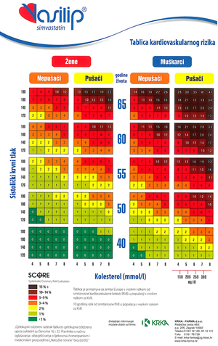
CV risk score

Slide 29
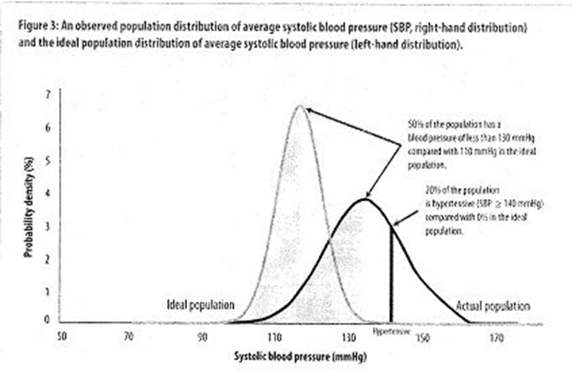
High risk versus low risk population groups

Slide 30
Possibilities of a systems biology aproach in managing simple, clinical parameters
A decisin-making relies on multiple factors, some of which still unidentified
A solution depends on complex, situated, a real life scenario
A systems biology methodology may prove useful
A tendency for using simpler, cheaper, widely available parameters
In family medicine, an electronic health record provides the opportunity for data collection and integration by using advanced computer-based techniques

